Slide 1


BUSMANAGEMENT
Trainer name : Name: YUVEDHA.R
JANANI.V

Slide 2

OVERVIEW
We will learn about how to develope Full stack web application that is basic Purple Bus management Application using Angular 10 and Spring Boot.
We will create some features:
Create Bus List
Update bus details
Delete bus details
View bus details.

Slide 3
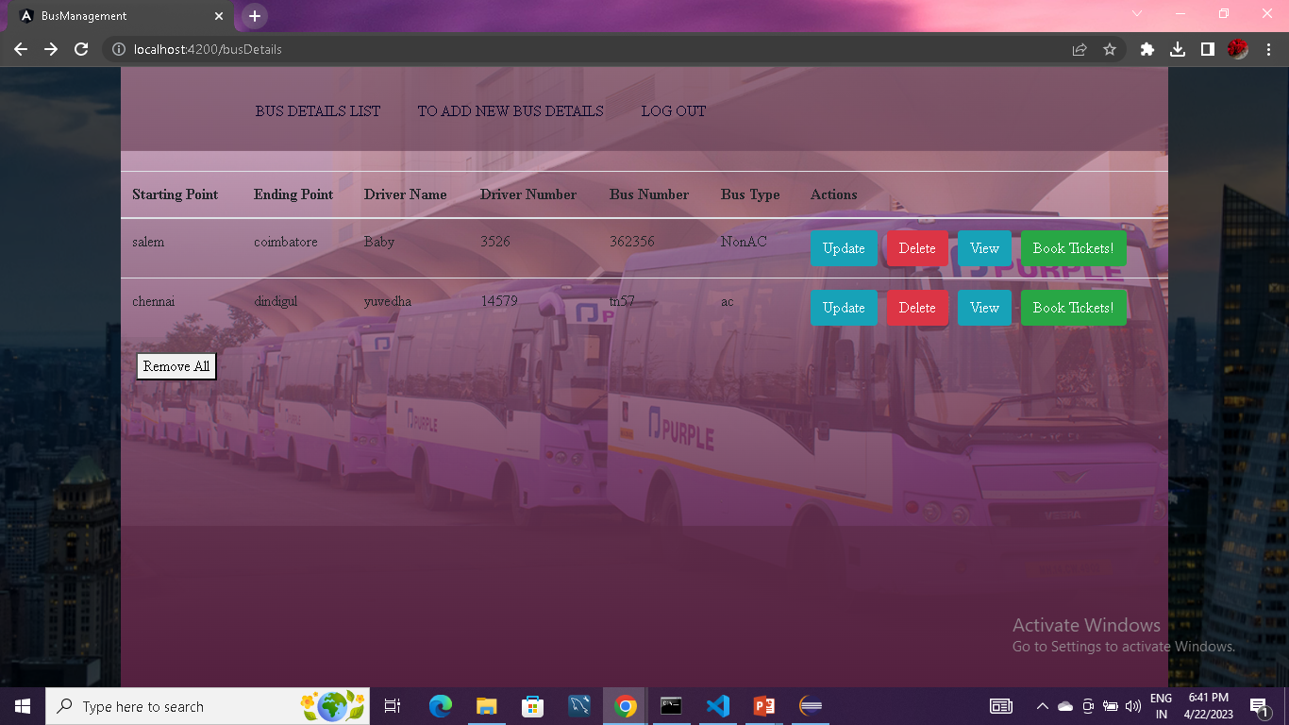
BUS DETAILS LIST

Slide 4
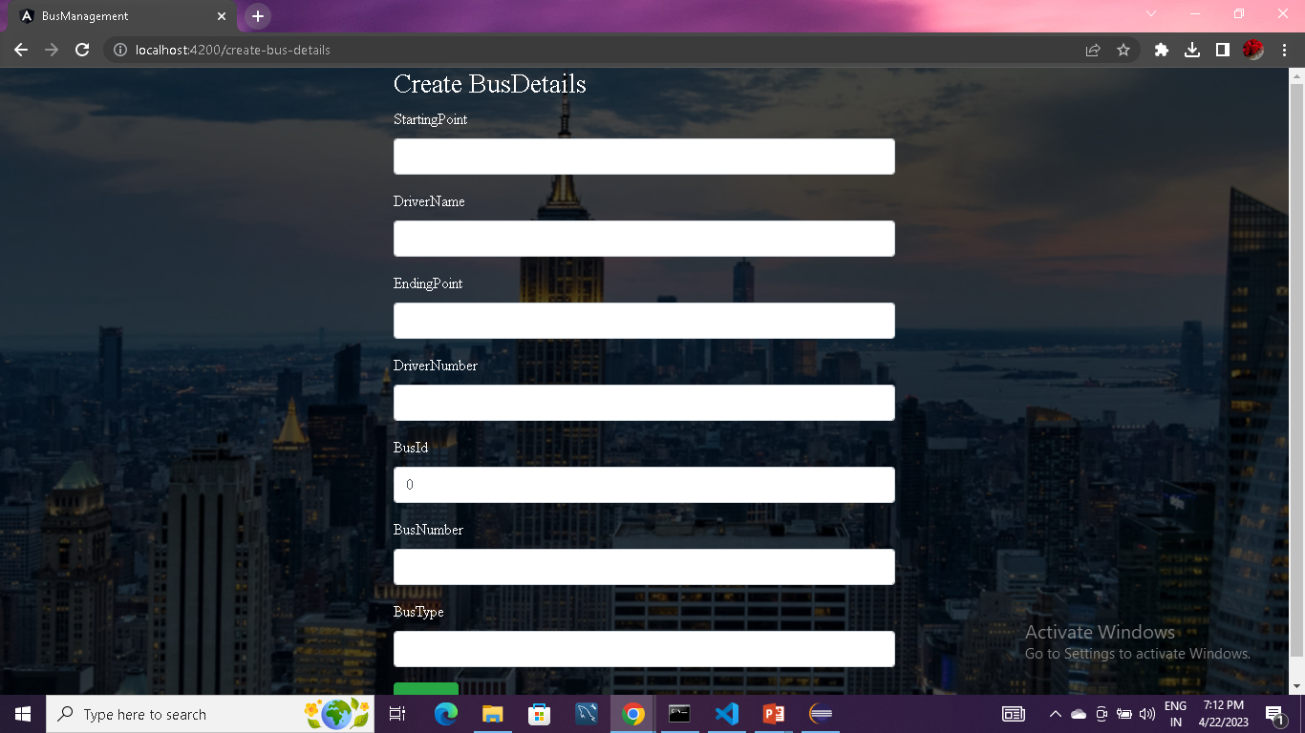
CREATE BUS DETAILS

Slide 5
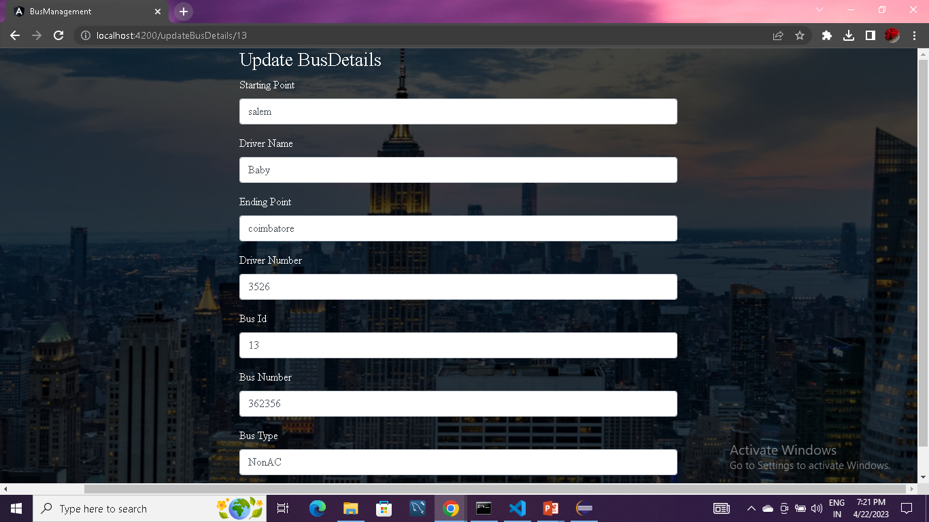
UPDATE BUS DETAILS

Slide 6
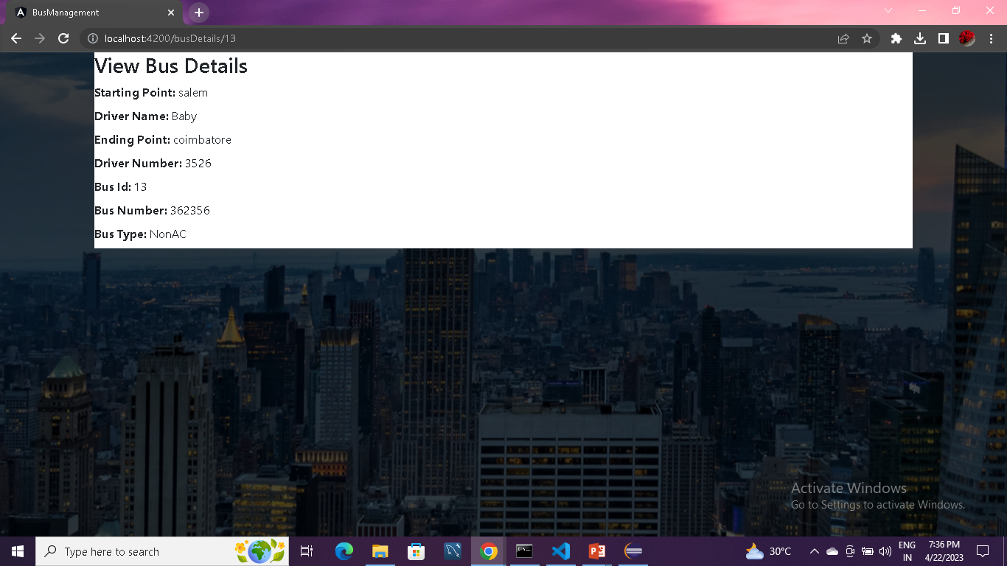
VIEW BUS DETAILS

Slide 7
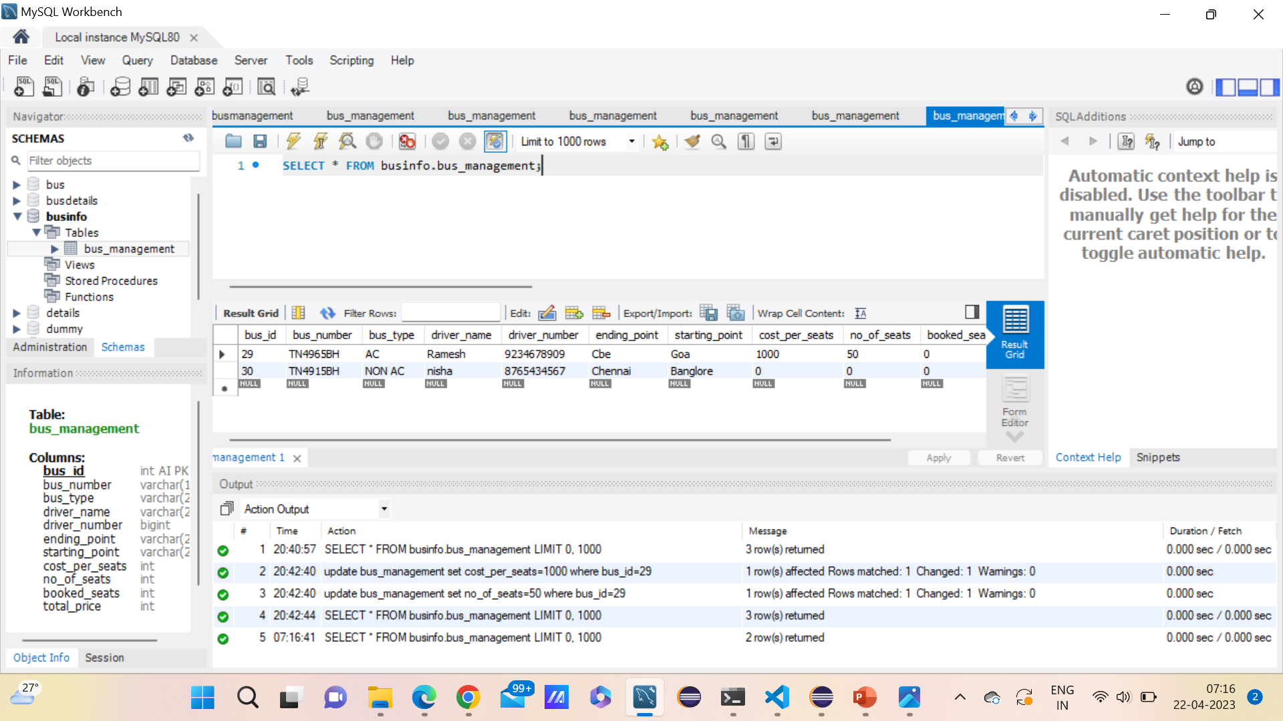
DATA BASE

Slide 8
TECHNOLOGIES USED
HTML,CSS,BOOTSTRAPCSS,JAVASCRIPT,ANGULAR
HIBERNATE,SPRING,REST API
MYSQL

Slide 9
ARCHITECTURE DIAGRAM
FULL STACK WEB DEVELOPMENT
FRONT END
BACKEND
DATABASE
HTML
CSS
BOOTSTRAP
JAVASCRIPT
ANGULAR
JAVA
HIBERNATE
SPRING
RESTAPI
MYSQL

Slide 10
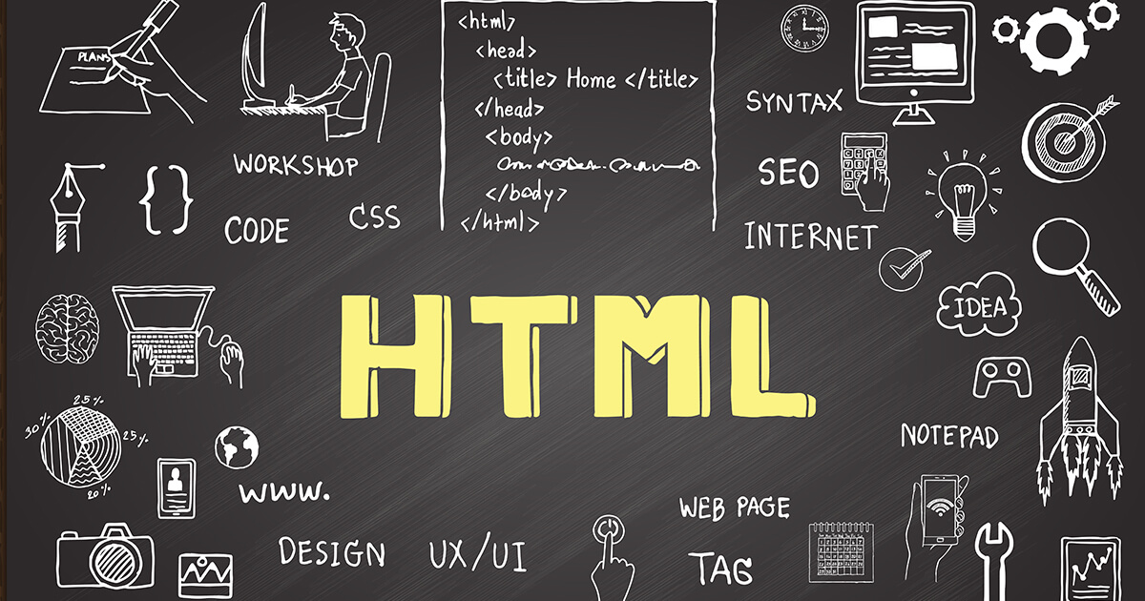

Slide 11
HTML
HTML stands for Hyper Text Markup Language
HTML is the standard markup language for creating Web pages
HTML describes the structure of a Web page
HTML consists of a series of elements
HTML elements tell the browser how to display the content
HTML elements label pieces of content such as "this is a heading", "this is a paragraph", "this is a link", etc.,

Slide 12
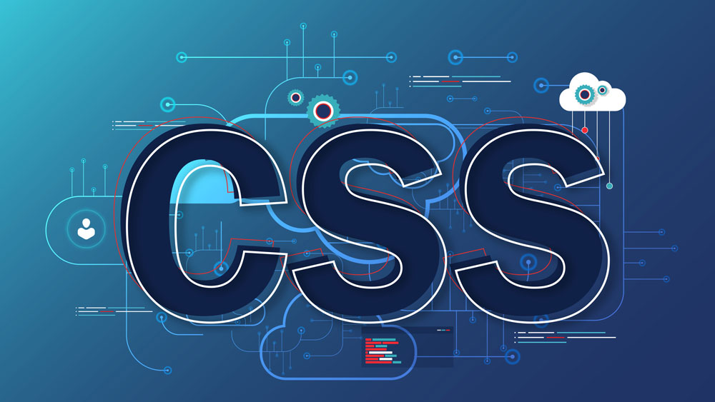

Slide 13
css
CSS (Cascading Style Sheets) allows you to create great-looking web pages
CSS is the language we use to style an HTML document.
CSS describes how HTML elements should be displayed.

Slide 14
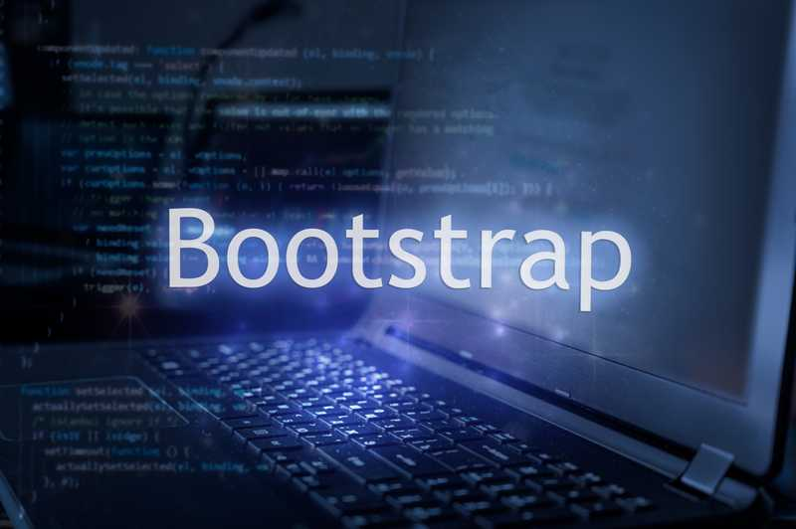

Slide 15
BOOTSTRAPCSS
Bootstrap is a powerful, feature-packed frontend toolkit.
Build anything from prototype to production in minutes.
Bootstrap is an open source toolkit for developing with HTML, CSS, and JS.

Slide 16
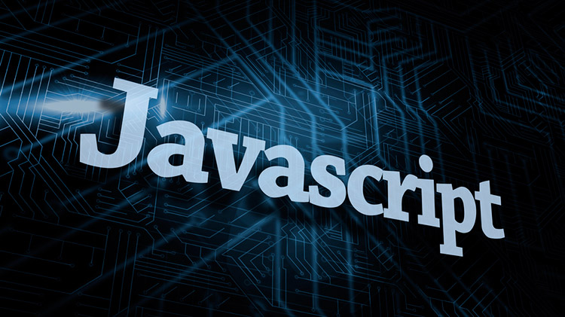

Slide 17
JAVASCRIPT
JavaScript is the world's most popular programming language.
JavaScript is the programming language of the Web.
JavaScript is easy to learn.

Slide 18
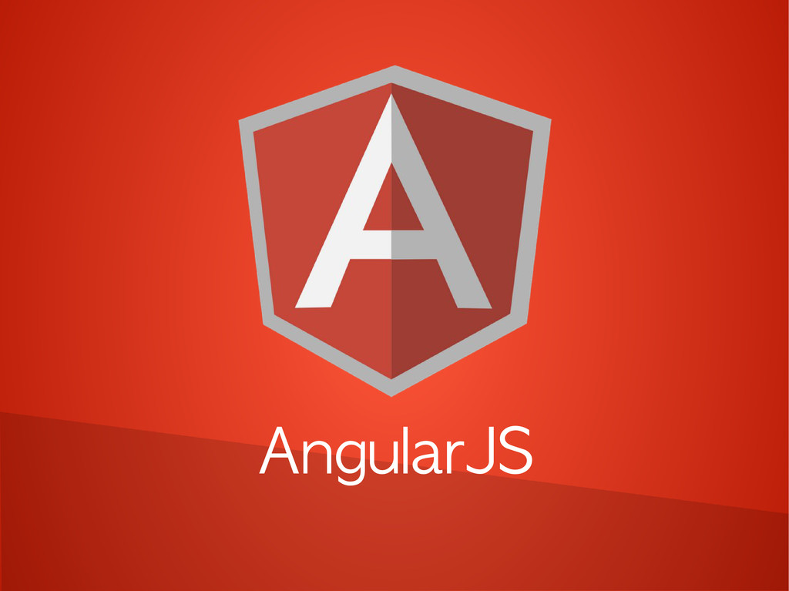

Slide 19
ANGULAR
Angular is a platform and framework for building single-page client applications using HTML and TypeScript.
Angular is written in TypeScript. It implements core and optional functionality as a set of TypeScript libraries that you import into your applications.

Slide 20


Slide 21
HIBERNATE
Hibernate is an (ORM) object–relational mapping tool for the Java programming language.
It provides a framework for mapping an object-oriented domain model to a relational database.
Hibernate handles object–relational impedance mismatch problems by replacing direct, persistent database accesses with high-level object handling functions.
Hibernate primary feature is mapping from Java data types to SQL data types.

Slide 22


Slide 23
SPRING
Spring is the most popular application development framework for enterprise Java.
Millions of developers around the world use Spring Framework to create high performing, easily testable, and reusable code.
Spring framework is an open source Java platform.
Spring is lightweight when it comes to size and transparency.

Slide 24
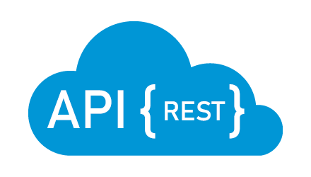

Slide 25
RESTAPI
Spring boot rest API is the intermediary programming interface of applications that enabled us to communicate two applications with each other.
It is a more common approach to build web services because using rest to develop web services is too easy.

Slide 26
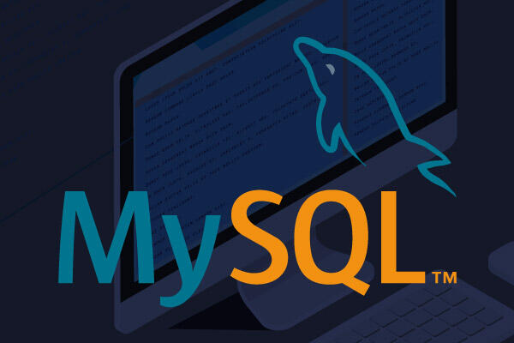

Slide 27
MYSQL
MySQL is a relational database management system
MySQL is open-source and free
MySQL is ideal for both small and large applications
MySQL is very fast, reliable, scalable, and easy to use
MySQL is developed, distributed, and supported by Oracle Corporation

Slide 28
ARCHITECTURE DIAGRAM
FRONTEND
BACKEND
Cross origin
Angular
Spring boot
FR
HTTP
Spring
restController
Spring data JPA
DB
mysql
Router
Component
service
Model

Slide 29
BACKEND FLOW
What happened when the spring boot application run? If you click run spring boot application . The Tomcat server is Started and main application context is kicked off which in turn search for the classes annotated with @Configuration, initializes all the declared beans in those configuration classes, and based upon the scope of those beans, stores those beans in JVM, specifically in a space inside JVM which is known as IOC container.
After the creation of all the beans, automatically configures the dispatcher servlet(Front controller).
Then it went to service interface where we have JPA Repository(where it as In Built Hibernate method such as Find all ,save , Find by id ) From JPA Repository it stores in Database and it get response in the form of JSON(Java Script Object Notation).

Slide 30
FRONTEND FLOW
Explanation:
Before Starting the Angular server we have to run Spring Boot Application.
When the server is Started in Angular first it comes into index.html. In index.html there is an App root it went to app module and
app Component . ts(app .component . html , app .component .css) and then it goes to app.routing.module.ts(path is given for all the sub components).
After that we have to create Subcomponent like create.update,list,view,login,logout,feedback,homepage,etc….
By Using these subcomponent there is service class in that we have to give base Url to connect backend Using @crossorgin annotation in service class.

Slide 31
FEATURES
Allows building loosely coupled applications.
Main feature is dependency injection.
Involves writing lots of boiler plate code.
Spring feature that enables project creation using cURL.
Spring CLI, Spring IDEs, and the Spring CLI all support the Spring Boot feature.
It doesn't generate any application code but provides a basic project structure.
All you need to do is write the application code.

Slide 32
THANK YOU

